Slide 1

Intelligence and AI Approaches
By Probir Sir

Slide 2
Topics to Cover
Intelligence
Types of Intelligence
Exploring Intelligence
AI Approach

Slide 3
Intelligence
Intelligence is the ability to acquire, understand, and apply knowledge and skills to solve problems, adapt to new situations, reason and make decisions.
American Psychological Association (APA) Dictionary of Psychology defines intelligence as “the ability to derive information, learn from experience, adapt to the environment, understand, and correctly utilize thought and reason.”
Britannica describes human intelligence as “the mental quality that consists of the abilities to learn from experience, adapt to new situations, understand and handle abstract concepts and use knowledge to manipulate one’s environment.”

Slide 4
Key Aspects of Intelligence
Learning: The ability to acquire and retain knowledge from experience.
Reasoning & Problem Solving: Applying logic and strategies to solve problems.
Adaptability: Adjusting to new situations and environments.
Memory: Storing and retrieving information when needed.
Creativity: Generating novel ideas and solutions.
Social Intelligence:: Understanding and interacting with others.
Self Awareness: Recognizing one’s own thoughts and emotions (in humans and potentially in advanced AI).

Slide 5
Types of Intelligence
Human Intelligence: Cognitive abilities in reasoning, learning and problem solving.
Artificial Intelligence: Machine based intelligence designed to mimic cognitive functions.
Emotional intelligence (EQ): The ability to understand and manage emotions.
Multiple Intelligences (Howard Gardener’s Theory): Includes logical mathematical, linguistic, spatial, musical, bodily kinesthetic interpersonal and naturalistic intelligence.

Slide 6
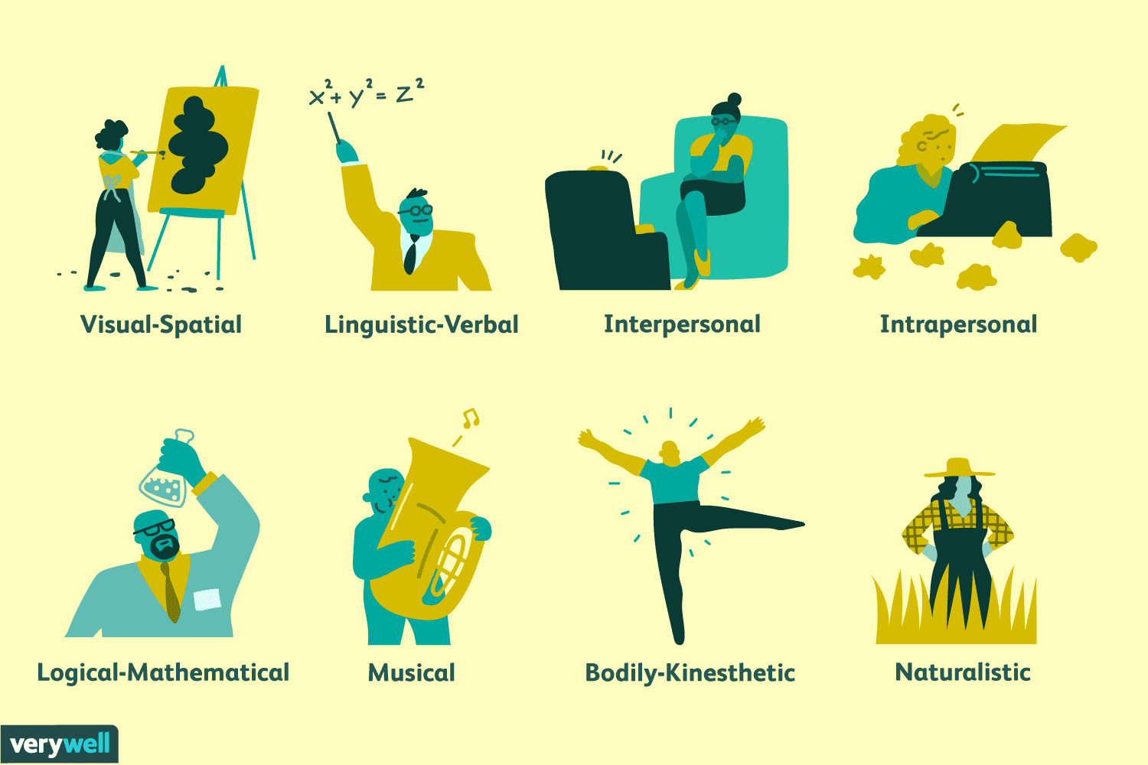

Slide 7
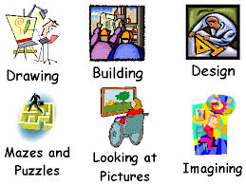
Visual Spatial Intelligence
Visualization and mental manipulation: The ability to form mental models of the world and manipulate objects and their relationships within a three-dimensional space. This includes mentally rotating or flipping objects and understanding how parts fit together.
Perceiving the visual world: Accurately perceiving the visual world, including shapes, colors, and patterns, and understanding how they relate to each other.
Problem-solving: Using visual information and mental imagery to solve problems, such as assembling furniture or navigating a complex route.
Examples: People with high visual-spatial intelligence might enjoy and be skilled at drawing, painting, sculpting, playing chess, and other visual arts. It is also a key component for many careers, such as engineering, architecture, and graphic design.

Slide 8
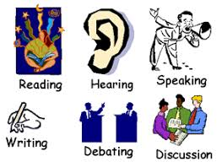
Verbal Linguistic Intelligence
Excellent Communicators: Skilled at expressing thoughts clearly, both verbally and in writing.
Word Smart: Good at memorizing words, learning languages, and understanding grammar, syntax, and semantics.
Effective Listeners: Can grasp nuances in spoken language and understand complex instructions.
Storytellers: Enjoy telling stories, writing poetry, and using metaphors.
Curious & Questioning: Often ask insightful questions and can explain complex topics simply.

Slide 9
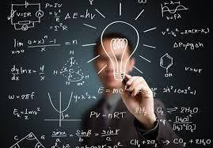
Logical Mathematical Intelligence
Logical reasoning: Ability to think in a step-by-step manner and make logical deductions.
Pattern recognition: Capacity to recognize and work with patterns, both numerical and non-numerical.
Problem-solving: A natural inclination and skill for solving complex problems and puzzles.
Abstract thinking: The ability to think conceptually and handle abstract ideas.
Mathematical aptitude: Proficiency in performing calculations and understanding mathematical operations.
Scientific inquiry: A tendency to conduct scientific research and design experiments.

Slide 10

Bodily Kinesthetics Intelligence
Skilful body control: A high degree of coordination and dexterity in both large and fine motor movements.
Object manipulation: The capacity to handle and manipulate objects with precision and skill.
Problem-solving: Using physical actions to solve problems or create products.
Mind-body connection: The ability to use physical activities to aid in learning and memory.
Enhanced learning: Learning through "doing" rather than passive observation.

Slide 11

Musical Intelligence
Sensitivity to Sound: Easily notice and distinguish pitches, rhythms, melodies, and instruments.
Musical Memory: Strong ability to recall songs, lyrics, and musical pieces.
Rhythm & Pattern Recognition: Innate sense of rhythm and ability to find patterns in sound and information.
Expression: Proficient in playing instruments, singing, composing, or using music to convey feelings.
Learning Aid: Uses songs, rhymes, and rhythms to remember other subjects.

Slide 12

Interpersonal Intelligence
Empathy & Awareness: Sensitive to others' moods, feelings, and intentions.
Communication: Skilled at active listening, verbal expression, and nonverbal cues.
Social Skills: Easily form networks, build rapport, and resolve conflicts.
Leadership: Motivate and influence groups, often taking leadership roles.
Teamwork: Enjoy group activities and collaborate effectively.

Slide 13
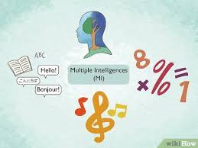
Existential Intelligence
Deep Questioning: Curious about fundamental questions of life, death, the soul, and reality.
Big-Picture Thinking: Ability to see the overall significance of events and one's role in the world.
Reflective & Introspective: Enjoys deep thought, examining personal beliefs and the nature of consciousness.
Philosophical & Spiritual: Drawn to philosophy, spirituality, or finding meaning in secular contexts like science or art.
Purpose-Driven: Motivated by finding personal purpose and making a meaningful contribution.
Challenging Norms: Open to new perspectives and questioning assumptions.

Slide 14
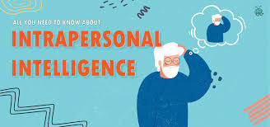
Intrapersonal Intelligence
Self-awareness: The ability to recognize and understand your own feelings, strengths, weaknesses, and motivations.
Self-reflection: Regularly thinking about your experiences, emotions, and thoughts to gain insight into your inner world.
Self-regulation: Managing your emotions and behaviors to respond appropriately to situations.
Decision-making: Using your understanding of your own needs, values, and limitations to make effective choices.
Personal growth: The capacity for continuous improvement and the development of a clear sense of self.

Slide 15
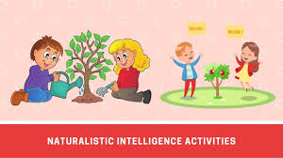
Naturalistic Intelligence
Nature Connection: Strong affinity for outdoor activities like hiking, camping, and gardening.
Observation Skills: Keen ability to notice patterns, subtle changes, and differences in plants, animals, and landscapes.
Classification: Enjoy identifying and naming species, rocks, clouds, and other natural items.
Environmental Sensitivity: Deep interest in ecology, conservation, and understanding how natural systems work.
Tool Use: Interest in tools for observation, such as microscopes or binoculars.

Slide 16

Exploring Intelligence
Exploring intelligence involves examining its diverse definitions, prominent theories in psychology, the study of artificial intelligence (AI), and its broader societal implications.
Intelligence is a complex and highly debated topic with no single standard definition among experts. Generally, it is considered the ability to learn from experience, adapt to new situations, and use knowledge to solve problems.
AI research and development have opened up new avenues for exploring the nature of intelligence, both human and machine.
AI as a Tool for Understanding Human Cognition: Researchers use AI models to test hypotheses about how the human brain processes information, such as vision and language acquisition.
Exploring the "Intelligence Space": AI allows scientists to explore alternative forms of intelligence that may differ from biological intelligence, essentially mapping the space of possible intelligent systems.

Slide 17
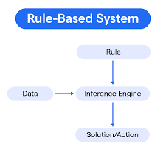
AI Approach
Rule based Approach: A rule-based approach in AI uses predefined "IF-THEN" rules, crafted by human experts, to process data, mimic human reasoning, and make decisions, forming the core of early expert systems and modern chatbots for structured tasks like fraud detection or customer service.
Knowledge Base: Stores facts and rules (e.g., "IF temperature > 102°F AND sore throat THEN consider strep throat").
Inference Engine: Applies these rules to input data (facts) to deduce conclusions, using methods like forward or backward chaining.
Deterministic: The same input always yields the same, predictable output, making it reliable for specific tasks.

Slide 18
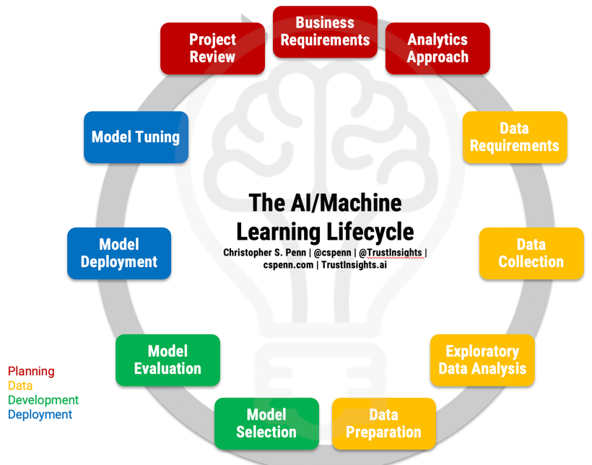
Learning Based AI Approach
A learning-based approach in AI, primarily Machine Learning (ML), enables systems to learn patterns and make decisions from data without explicit programming, improving performance over time by identifying trends, classifying data, and predicting outcomes.
Self-Learning: The system learns from raw or labelled data to find patterns and relationships, rather than being given fixed rules.
Data-Driven: Performance hinges on the quality and quantity of data it's trained on.
Adaptability: Models can adjust and become more accurate as they process new information.

Slide 19
Conclusion
Intelligence makes human being unique in this world and human intelligence developed new model of intelligence to explore more about the world. This unique feature make our world very much different than the other living world in nature. Natural and Artificial both type of intelligence are making progress towards giving a new lease of life that is a new dimension and approach towards life in general.

